Slide 1
Notes:
How to use this slide show:
A trainer script is in the notes page of each slide. Under the “view” menu, choose “notes page.”
Before making any changes to the notes, save your own copy of the slides.
Suggested wording is provided (in italics) to give trainers ideas for smooth transitions, but trainers can of course use their own wording.
Trainers should use examples to illustrate points. Some examples are provided but trainers may use their own. Places where examples are helpful are marked in red.
You may hide or unhide “key dates” slides by right clicking over the slide in the left panel of “normal” view and clicking “hide.”
Some slides have notes that are there just in case you are asked a question. We made an intentional decision not to cover some things unless a question crops up.

Slide 2
Disclosure 101:
Candidates and Committees
Presented by:
Ashley Carlson
Ladelle Fuquay
Scott Haley
Diana Izaguirre
Notes:
Facilitator (or trainer):
Welcome guests and introduce self
Before we move into the content of this class, I’ll take us through some foundational items

Slide 3

Zoom Logistics
Cameras & microphones
Using the chat box
Chat is saved
Class not recorded
Notes:
Facilitator (or trainer):
Talk about cameras and unmuting (based on group size)
Share that PDC does save the chat in order to remember questions and follow-up when needed
Mention closed captioning and to private chat if help is needed
Share that class is not recorded
We do have some recorded material on YouTube. You can search WA State Public Disclosure Commission on YouTube. However, what you will hear today is the most current information, so we’re glad you are here.

Slide 4



Why This Class?
Increase your understanding
Increase your confidence
Decrease reporting errors
Notes:
Facilitator (or trainer):
This session is geared to candidates and committees
Our goal is to…(run through slide)
The bigger picture is that when you understand the regulations, there is greater government transparency which is good for the voters
Toward today’s objectives, we’ll be covering several topics (click to next slide for topics)

Slide 5
Today’s Agenda
Overview of PDC
Overview of reporting
Contributions
Break (10 minutes)
Volunteers
Fundraisers
Expenditures
Debt
Advertising
How to get more information
Notes:
Facilitator (or trainer):
You can see today’s topics here; the contributions section is probably the longest
We will take a break about halfway through
What we won’t be doing is answering questions that are very specific and unique to one person, but we’ll tell you how to get those questions answered
We also won’t be showing you how to report online using the system we call ORCA. We have another class that covers that, which you may have signed up for.
This class is scheduled for 3 hours, but we often end early depending on questions
As we go through the topics, remember that most of what you will hear today can also be found on the PDC website
It will help us to know something about who is here today
Ask participants to put roles in chat box (candidate/committee rep/treasurer, etc.)
Launch Zoom poll about highest area of interest
Thank you for that
Now to a quick overview of the Public Disclosure Commission

Slide 6
About the PDC
RCW 42.17A
WAC 390
1972 ballot
Initiative 276
“The public’s right to know of the financing of political campaigns and lobbying and the financial affairs of elected officials and candidates far outweighs any right that these matters remain secret and private.”
Notes:
Facilitator (or trainer):
The Public Disclosure Commission was created by the people in 1972, with the passing of Initiative 276 (note: 72% in favor)
Disclosure laws are now found in the codes you see referenced on the slide
The quote on the slide comes directly from RCW and emphasizes the reason for the creation of the PDC and the laws
We, and you, have responsibilities to the people of Washington to ensure truthful and accurate reporting and, in turn, to promote confidence in the political system
Our commissioners’ vision is to lead the nation in fostering full disclosure of money in politics – to be the gold standard
If you are a candidate, you will likely work with government agencies beyond PDC, such as the Secretary of State or your county auditor’s office. The City of Seattle has local filing requirements.
If facilitator: Introduce trainer
The PDC has 37 employees and some of them are what we call “Filer Assistance Specialists”
I’d like to introduce one of those experts now and turn things over to them

Slide 7
Reporting Overview
Candidates & Committees
Notes:
Trainer:
Let’s start with a general overview of candidate and committee reporting and then we’ll get more specific
Public disclosure is all about money going in and out
In a nutshell, if something of value happens in a campaign, it needs to be reported

Slide 8
You become a candidate when you…
Raise or spend money for your campaign,
Reserve space or purchase advertising to promote your candidacy,
Authorize someone else to do either 1 or 2,
State publicly that you are seeking office, or
File a declaration of candidacy
Notes:
If you’re a candidate, for PDC purposes your campaign begins with the earliest instance of any of these things
You become a candidate when you…(talk through slide)
A candidacy begins right when one of these occurs even if it is years before an election
For example, someone might start raising money for their campaign in 2025, for an election in 2028
IN CASE SOMEONE ASKS:
“State publicly” can be different things. It would be something like telling a reporter you are running, but it would not be telling family at the dinner table.

Slide 9
You become a committee when…
Your organization first has the expectation of receiving contributions or making expenditures in support of, or opposition to, any candidate or any ballot proposition.
Notes:
What about those of you representing committees?
A committee is formed at the time…(read slide)
There are many types of committees:
Mention examples of choice, such as:
Groups supporting state or local initiatives
School bond or levy committees
Political action committees like Boeing PAC
When two or more people pool their funds to make expenditures to support or oppose a candidate or ballot measure, they are considered a political committee

Slide 10
Reports Referenced Today
WHAT | WHO | WHY
F-1 financial affairs | - All state/county candidates - Some local candidates | Report personal finances
“C” reports | - All state/county candidates - Some local candidates - Some committees | Register and report on campaigns
Reporting guidance is on our website.
Notes:
Do not go into details on this slide – it’s intended to give a visual snapshot
Candidates and committees have various reports to file
You will hear a few reports referenced today and this chart is an overview of some of those
We’ll discuss the F-1 in a few minutes
The C reports are used for different purposes, and we’ll get into some of those as we move along
So, more details coming

Slide 11

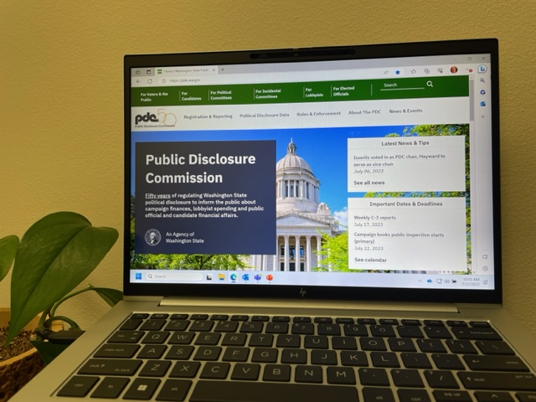
Key Point
All reports must now be filed electronically.
Notes:
It’s important to know that all reports we’re focusing on today must now be filed electronically
Reports can’t be faxed or emailed
For the major reports, you can use our reporting system, called ORCA (Online Reporting of Campaign Activity), or an ORCA alternative from a third-party vendor
If you’re using ORCA, you may choose to attend our class on that system
If you’re using an alternative, or are interested in knowing more about third party campaign management software, you’ll want to contact those vendors directly
At the end of this class, I’ll take you to our website and show you where PDC reporting begins

Slide 12
State and county-wide candidates must…
File Personal Financial Affairs Statement (F-1)
File Candidate Registration (C-1)
File within 2 weeks of becoming a candidate.
Notes:
Once you become a candidate, what reports do you need to file?
Right out of the gate, state-wide and county-wide candidates in most cases need to file two major reports within 2 weeks of becoming candidates
Remember, that might be years before an election
State-wide offices would be things like Governor, Secretary of State
County-wide offices would be offices like sheriff, or county commissioner
Within 2 weeks you will file…(Name the two reports on the slide)
The requirement to file these forms is not in any way connected to how much money you bring in or spend – it’s about the office the candidate is running for
Other reports come along later, but these are needed right away

Slide 13
Local Candidate Filing Requirements
# OF VOTERS | MONEY RAISED | F-1 | C REPORTS
Under 2,000 | Less than $7,000 | NO | NO
2,000-4,999 | Less than $7,000 | YES | NO
5,000+ |  | YES | YES
These rules also apply to judicial candidates.
File within 2 weeks of becoming a candidate.
Notes:
Here are the reporting requirements that apply to local offices such as… (offer examples: city council, fire commissioner, etc.)
You can see on this chart that reporting requirements are determined by the number of registered voters and money raised by the campaign
Talk through chart, row by row
The registered voter count looks at the whole jurisdiction based on the last general election
If you can’t find your voter count, the PDC can help you with that
IN CASE SOMEONE ASKS:
For top two rows, if you do reach $7,000, you must file F-1 and C-1, and report contributions and expenditures back to the beginning of the campaign
2,000 voters was recently changed from 1,000
$7,000 includes candidate’s personal funds and all other money donated to campaign

Slide 14
The F-1 Personal Financial Affairs Statement
Required for most
Even first-time candidates report previous 12 months
About personal finances, not campaign
  Income range and sources
  Assets
  WA real estate
  Debt (excluding credit card)
  Businesses you own (10% or more) or serve in a position
  Lobbying
  Gifts and travel (if currently holding office)
Notes:
Let’s talk for just a minute about the F-1 Personal Financial Affairs Statement
People are often surprised this report is about personal finances, not about a campaign
In fact, most states require a personal financial disclosure, because it serves as way of checking for conflicts of interest
The F-1 is required for many state, county, and local candidates, both new and returning
Again, first-time candidates file this within 2 weeks of becoming a candidate for the 12 months prior, and only have to file it once, until elected
Elected officials file annually by each April 15, but not if they’ve already filed that year
The application will determine your annual filing date, based on your answers to the initial questions
The F-1 asks about the 7 topics you see on the slide, but it doesn’t require you to enter things like account numbers or exact dollar figures – it’s intended to capture a snapshot; an overview
We aren’t going to cover the F-1 topic details in this class, but we want you to know to expect them
By the way, on YouTube we have recorded videos on how to complete the F-1 and we do have a class coming up titled Understanding the F-1 and if you attend, you’ll meet Scott and Ladelle, two more DS.

Slide 15
Committees must…
File Committee Registration (C-1pc)
File C-1pc within 14 days of becoming a committee.*
*This is reduced to 3 business days if the election will be held within 3 weeks.
Notes:
Jumping briefly back to political committees…committees must register using the C-1pc
That needs to be filed within 14 days of becoming a committee unless the election will be held within 3 weeks, in which case it must be filed within 3 business days because the election is so close
In some cases, committees will file other C reports, which we’ll get to next

Slide 16
Choose Your Reporting Option
MINI-REPORTING if:
No more than $7,000 raised or spent
No more than $500 per contributor
No contribution or expenditure reports* (do keep records!)
FULL-REPORTING if:
More than $7,000 raised or spent
More than $500 per contributor
Must report contributions and expenditures*
*See website for exceptions.
Notes:
There are several types of C reports
Which reports you need to file will depend on your reporting method
When you register online as a candidate or committee, you will be asked about whether you plan to do mini or full reporting
Cover slide points on mini (remember these are aggregate #s – over the course of campaign)
Cover slide points on full
You may wonder “What if I want to switch from mini to full?”
If you aren’t sure whether you will exceed the requirements of mini, we recommend that you choose full because it is easier to switch back to mini, than vice-versa
It is possible to move from mini to full – it is a more complicated process
There are deadlines and approvals required, so you’ll want to pay attention to details if you do need to switch, don’t exceed the $7000 threshold, and please don’t wait until the last minute because it takes time to get through the process
You can reach out to us if you need help with that
IN CASE SOMEONE ASKS:
For a continuing committee, this is $7,000 per calendar year, for an election campaign, $7,000 per campaign
Contributions by candidate do count toward $7,000
Contributions do include monetary and in-kind
$500 per contributor does NOT include candidate, who can give more
Continuing committee must choose reporting method every January

Slide 17
Key Point
Good reporting begins with good record-keeping. Regardless of your reporting method, always keep accurate, detailed records for at least five years.
Be prepared for campaign records requests.
Notes:
This is a key point
Read whole slide
A campaign records request can come to a committee or a candidate in the 10 days before any election they are participating in
Your records can be requested by the public whether you are doing mini or full reporting
Records requests will come to the email address registered with the PDC
It is something you will want to watch for and be prepared to respond to
Are there any questions about that?

Slide 18
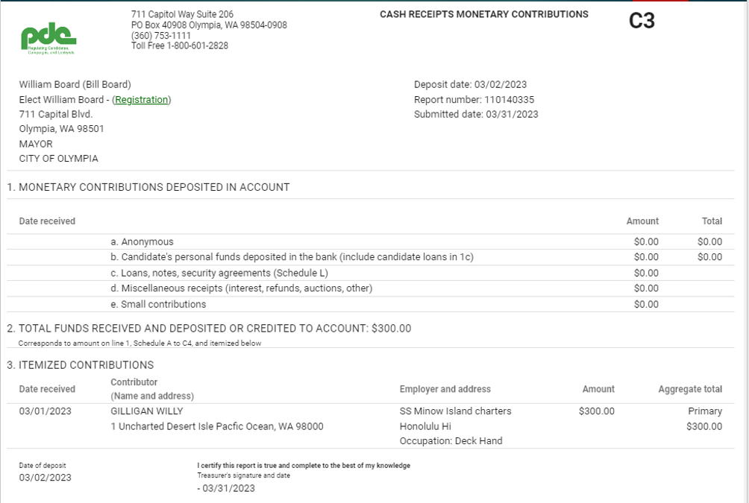
Full Reporting: The C-3
The C-3 reports monetary contribution deposits.
Notes:
If you are doing full reporting, you will need to file the C-3
The C-3 is how you report monetary contributions put into the bank
Money needs to be deposited within 5 days of receiving it
You may choose to file a C-3 for each deposit you make
However, you are also permitted to use one C-3 report for all deposits made on the same day
Generally people file a C-3 for each day they deposit
The ORCA training demonstrates the C-3

Slide 19
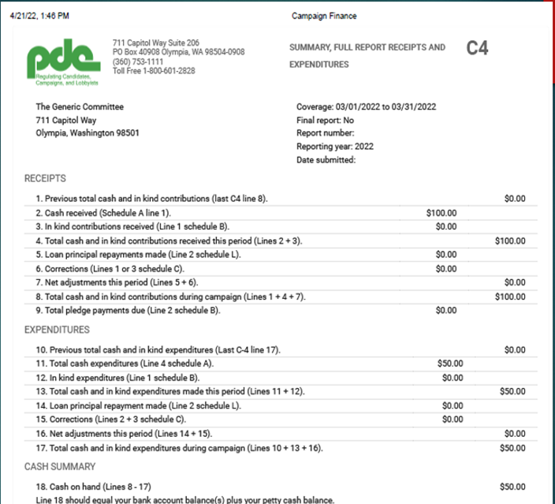
Full Reporting: The C-4
The C-4 reports money in and out, including “in-kind” contributions.
Notes:
Those doing full reporting will also need to file the C-4
The C-4 summarizes financial activity - both money in and money out, including “in-kind” donations of time, talent, and tangible items, which we’ll go into soon
Parts of the C-4 show expenditures, pledges, and other items
This report will also reflect your campaign’s bank balance
To be clear, the C-4 isn’t electronically connected to your campaign bank account but rather is a summary of what you’ve entered in ORCA
One important part of the C-4 is Line 18 – you might jot that down because Line 18 is important to pay attention to
If Line 18 is a negative number, it means your bank account is overdrawn and you will want to figure out whether that is true or a reporting error
You’ll hear much more about this if you attend ORCA training

Slide 20
Contributions
Notes:
Natalie launch Zoom poll on record retention
Let’s zero in on contributions
Today we need to cover quite a few points about contributions, because handling contributions correctly is one of your most important reporting tasks
However, we won’t cover every possible situation, because there are many intricacies
We use the term “contributions” broadly to refer not just to money, but to items and services that assist a candidate or committee

Slide 21
Accepting Contributions
Separate bank account needed to accept contributions
Candidates can be their own treasurer
Anonymous contributions cannot exceed:
  $500 per calendar year, or
  1% of total per calendar year
  Whichever is greater
Notes:
First, in order to accept contributions, candidates must have a separate bank account for the campaign (you don’t need a separate account if you aren’t accepting money)
It is fine for a candidate to be their own treasurer
We’ll be talking about the information that needs to be reported about contributors, but you must also know the rules about anonymous contributions (explain limits on slide)
You don’t choose to make contributions you receive “anonymous;” they are donations for which you truly don’t know who the donor is
You also should not solicit anonymous contributions
In fact, when you don’t know a contributor, you need to make an effort to find them and document your efforts
Offer example such as finding $100 on the table at a fundraiser and what you would do
If you eventually discover who a donor is, you can always amend a report
What if you exceed your limit of anonymous contributions? If that happens, you will be writing a check to WA State Treasurer in the amount of the overage
Are there any questions about anonymous contributions and the limits on this slide?

Slide 22


Key Point
You must have a way of collecting the information you are required to report about your contributors.
Don’t solicit anonymous donations.
Notes:
Here is something very important to know
Read slide
So, putting out a jar labeled “donations” would not be acceptable

Slide 23
Reporting Common Contributions
COMMON TYPES | AMOUNT/VALUE | WHAT TO REPORT ABOUT CONTRIBUTOR
Monetary contribution | Over $100 total Over $250 total | Name; address Name; address; occupation; employer name, city, and state
In-Kind (goods/services) | Over $100 total Over $250 total | Name; address Name; address; occupation; employer name, city, and state
Pledge | $150 or more | Name; address
There are other types of contributions. Ask us or see our website.
Notes:
Most contributions will fall into these main categories and this chart shows what the law requires that you report
Talk through chart and be sure to:
Make it clear the $100 and $250 are the total from the person, across campaign (aggregate, not one contribution)
Offer examples of, in-kind contributions: donated office space free or reduced cost printing, office supplies
Very common mistake: reporting in-kind contributions as monetary
Another common mistake: neglecting to gather the employer information
IN CASE SOMEONE ASKS:
2024 guidance on reporting employer:
Multiple employers - ask the contributor which employer or occupation represents the largest share of their income
Location unclear - report the location of the office where they work, the office where they would report if needed, in the case of teleworkers, or if they have no duty station, the company’s HQ
Unable to get info - campaigns are advised to return the contribution

Slide 24
Receipts NOT Reported as “Contributions”
Bank interest
Vendor refunds
Reimbursement from another campaign for shared expenses
Contributions returned within 10 days
Some volunteer services (more on this later)
Notes:
A candidate or committee occasionally receives money not considered a contribution for reporting purposes; these items don’t count toward contribution limits
Details about this are linked in your class email
These include…(talk through this slide and next slide)
Note that contributions returned within 10 BUSINESS days are not reported as contributions

Slide 25
Receipts NOT Reported as “Contributions”
Volunteer expenses of less than $200 across the campaign
Home hospitality expenses (no fees; no contributions)
Some signage and other communication contributions
See more on our website.
Notes:
Talk through this slide, being sure to:
Offer examples of home hospitality such as: coffee hours, cocktail parties, wine and cheese parties, where purpose is to meet a candidate or organize a campaign and where no fee is charged, or contributions expected
There are some other specifics on our website you will want to check out which will become ingrained as you get used to reporting
IN CASE SOMEONE ASKS:
Home hospitality event must have no solicitation of money, including distribution of envelopes, and no acceptance of money. If funds are raised, they are contributions now and money spent for the event is an in-kind contribution.

Slide 26
Contribution Limits
See chart (link in class email)
Limits changed 4-1-23 to reflect inflation
Consider primary and general elections separately
Two-party checks divided equally unless specified
$7,500 limitation 21 days before general election
Notes:
For most races, there are contribution limits
In your class email, there is a link to a printer-friendly chart of those limits
You can read the amounts on the chart, so I won’t go over them now
I will tell you that limits changed in 2023 to reflect inflation
Contribution limits on your chart are per election, meaning for each ballot you are on (the primary and the general)
If a candidate makes it through the primary and goes on to the general, they may spend the surplus primary money on the general election. If a candidate gets a contribution for the general, before the primary election, and they’re on the primary ballot, they may not spend that money for the general until after the primary.
Likewise, a candidate cannot receive money for the primary after the primary election, unless they lost the primary and have debt, in which case people can donate toward your debt for up to 30 days
Next, when determining contribution limits, it’s important to correctly track two-party check donations: if you receive a contribution written on a two-party check, you should record the contribution as split equally between both parties on the check, unless they instruct differently
For example, in the case of a $100 check drawn on the account of John and Mary Smith, attribute $50 to John and $50 to Mary
You split that donation, even if only one person signed the check, unless they specify otherwise
Finally, there is a general restriction that says that no 1 contributor may make a “last minute contribution” of more than $7,500 to a campaign and that includes a candidate contributing to themselves
This restriction applies to most offices, but not statewide offices (if asked, statewide office is $75,000)
“Last minute” refers to the 21 days before the general election
IN CASE SOMEONE ASKS:
Port commissioner limits used to apply to only large districts; no longer
General election money can’t be spent until after primary. If you don’t go to the general, all contributions attributed to the general election must be returned, regardless of debt level.

Slide 27
Candidate Loans
Money given to a campaign, with the expectation of repayment
Reported to PDC
Governed by a written agreement between campaign and loaner
$7,500 repayment limit per election
21 days turns a reimbursement situation into a loan
Notes:
In your class email there is a link to information on our website about loans, but let me explain
Candidates will often contribute to their own campaigns, with the expectation of getting that money back once the campaign has enough money
We call that a loan – a loan to the campaign from someone – usually the candidate themselves – and it should be reported as a loan
This type of situation needs a written loan agreement
With a written loan agreement in place, the loaner can be repaid up to $7,500 per election
Now, if the candidate does not want to be paid back, they can just make a contribution to their own campaign
Or, if a candidate knows for sure they will be paid back within 21 days, they can request a simple reimbursement from the campaign
However, once 21 days have passed, any money given by a candidate to their campaign cannot be repaid unless that written load agreement was in place before reaching 21 days

Slide 28
Foreign Contributions
No foreign national financing or involvement in decision-making
Collect a “certification” if donor is not an individual person
  For each contribution they make; very limited exceptions
PDC provides a sample certification
Notes:
There are contribution restrictions around foreign contributions
Foreign nationals cannot be involved in contributions, expenditures, or decision-making in any campaign
A foreign national is a person with foreign citizenship or a foreign business or corporation
The exception is that individuals with “green cards” may contribute to elections in the U.S. AND a foreign business with a U.S. subsidiary may contribute
The law also requires organizations to certify that contributions they make do not include foreign involvement
The PDC has a certification form you can use (click to next slide to show)
IN CASE ASKED:
In 2020 the legislature passed Substitute Senate Bill 6152 and added the certification
For more information on SSB 6152: WAC 390-16-330

Slide 29
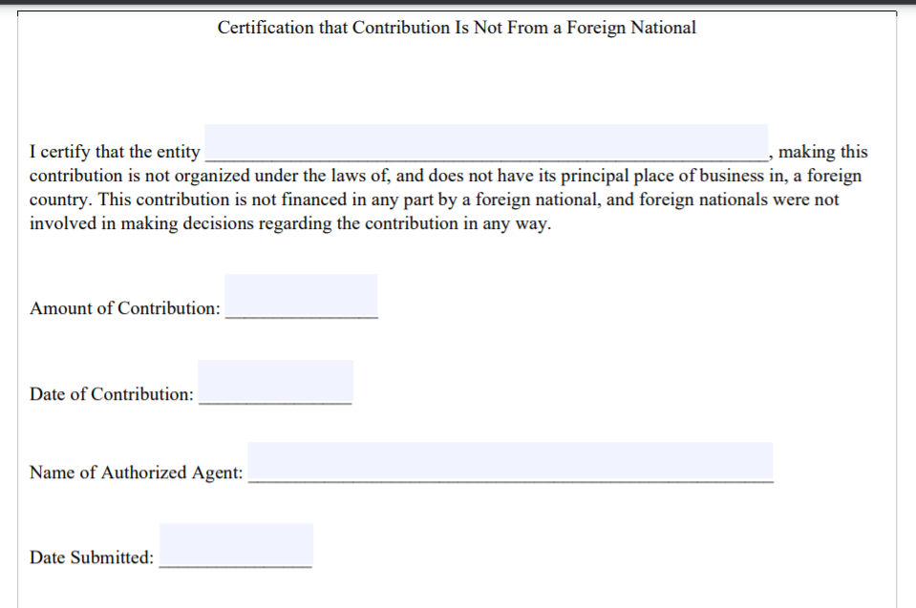
Sample Certification
Use our sample or use your own form.
Notes:
There is a link to our form in your class email
You can use our form or your own, but certification must be in writing
And if you use your own form, you’ll want to collect the same information we ask for on ours
You should keep all of the certifications you receive with your campaign records

Slide 30
If no certification, campaign may…
Hold the contribution in regular bank account until the next PDC report is due, or for 10 days, whichever is later
OR
Segregate the contribution to prevent it from commingling with other contributions, for up to 30 days
Notes:
If you receive a contribution with no certification from the organization, you have a couple of choices
Talk through slide
If the issue of foreign financing is relevant to you, you will want to look at the details on our website
Are there any questions right now about foreign involvement?

Slide 31
Volunteers
Notes:
Natalie launch poll before break
TAKE BREAK
Should be about 1 hour in when go to break
After break:
Earlier I mentioned that some services performed by volunteers are NOT considered contributions and don’t count toward contribution limits
Let’s talk more about that now

Slide 32
Common Volunteer Services
Office or event staffing
Planning events
Handling mail/email
Surveying/polling
Getting out the vote
Scheduling appointments
Helping with compliance
Website or social media work
Building or placing signage
Driving candidates/voters/staff
Notes:
Here are some campaign activities that are commonly done by volunteers
By the way, this information is linked in your class email
While engaged in these types of activities, the volunteer is giving of their time and talent, so you might assume it is an “in-kind” donation and must be reported
However, if certain conditions are met, you don’t need to report these services as in-kind contributions at all, and they don’t count against limits
(Info on next slide – click to it before continuing)

Slide 33
Volunteer services…
Aren’t “contributions” if the volunteer isn’t:
  Compensated for the work
  Ordinarily paid for this type of work
Don’t count toward contribution limits if these conditions are met
Include some exceptions for attorneys and accountants
Notes:
Volunteer services aren’t contributions if the volunteer isn’t compensated by anyone for the work and isn’t ordinarily paid for this same type of work
In terms of being compensated for the work, I will add that if the volunteer serves while on paid leave that they’ve earned, they are still not considered “paid” for the volunteer work
So again, if these conditions are met, the volunteer work doesn’t count toward contribution limits
There are some exceptions for attorneys and accountants
Attorneys or accountants, whether they are being paid by their employers or are on their own time, may provide their professional services 1) to a candidate to assist that candidate in complying with state election or PDC laws, or 2) to a bona fide political party or caucus political committee for any purpose.
These professionals may not provide similar services to any other type of political committee.
If conditions are not met, the committee must pay the fair market value of the services rendered or an in-kind contribution must be reported for the fair market value of the services rendered.
But again, if these conditions aren’t met, the volunteer work becomes an in-kind contribution and must be reported

Slide 34
Fundraisers
Notes:
We have one more topic to cover in the contributions section
Some of your contributions may come from fundraisers
I want to highlight what we call “low-cost fundraisers” because they qualify for more limited tracking and disclosure and are therefore appealing to some people
These fundraisers are addressed in a link in your class email and reporting on them is discussed more in our ORCA class

Slide 35
5 Types of Low-Cost Fundraisers
Retail sales at fair market value
A lawful gambling operation
Food or beverage event with stated admission $100 or less
Entertainment event with stated admission $100 or less
An auction with items valued at $150 or less per donor
Notes:
There are 5 types of low-cost fundraisers
The first is retail sales at fair market value, such as T-shirts. If you are selling a 3-color T-shirt the quality of Hanes, you need to research the average cost of comparable items and document your research to prove it is fair market value
A lawful gambling operation would be something like a raffle, and you would need to check the Gambling Commission rules before hosting
A food & beverage event would be something like a spaghetti feed, and you would need a stated admission price of $100 or less and no solicitation of contributions. This would also include just selling food, like burgers at a fair, so long as the burgers were no more than $100 each.
The fourth option is an entertainment event with the same rules as the food event
Lastly, you could have an auction where all items donated to be sold were valued $150 or less per donor
It’s important to know that if someone pays more than $150 to participate in a low-cost fundraiser, that money should be segregated from the proceeds of the fundraiser and reported like a regular contribution. For example, if the low-cost fundraiser is an entertainment event with a cost of $30 per ticket, and someone buys more than $150 worth of tickets, that person’s contribution would be reported under the person’s name and not as part of the low-cost fundraiser proceeds.
Sometimes people ask if they can have more than one low-cost fundraiser going at one time. For example, a $25 spaghetti feed that includes a $5 raffle. The answer is yes!
Remember, if one of these conditions in bold on the slide is not met, the whole event no longer qualifies as “low cost,” and all contributions must be reported with more detail
IN CASE ASKED:
Donations of $150 or less can be lumped together
Donations of more than $150 from any one person must be reported like a regular contribution
If people send a check before or after event instead of paying at door, and attend the event, you may treat their contribution like other funds received for event
If someone does not attend the fundraiser, but sends along a contribution anyway, that money is treated as a regular contribution and is not lumped together with fundraiser receipts
Funds received for an event may appear on more than one C-3, since money will trickle in both before and after the event

Slide 36

On Using Public Agency Facilities
State law restricts the use of public facilities to support or oppose candidates or ballot measures.
Notes:
This is a good time to mention that you cannot use public agency facilities to assist in campaigns unless it is the normal and regular behavior of the agency, with few exceptions
You can’t use them for fundraisers or for ANY aspect of the campaign unless it is the usual practice for the facility and doesn’t give special consideration to your campaign
So, if a public library regularly rents their room to any group, they can rent it to you

Slide 37
Expenditures
Notes:
Let’s move on to campaign expenditures
An expenditure includes many types of spending and might even be an agreement to make a payment
All expenditures made by a committee or candidate must be reported.

Slide 38
Reporting Common Expenditures
COMMON TYPES | WHAT TO REPORT ABOUT EXPENDITURE
Vendor purchase | Vendor name and address
Reimbursement | Item purchased, vendor name and location, person reimbursed
Consultant services | Work provided, date, name and address of vendor/sub-vendor
All candidate campaign expenditures must be related to the campaign.
Notes:
This chart shows what you will need to report about common types of expenditures
If it’s a vendor purchase, report the vendor's name and address
If it’s a reimbursement, report what was purchased, where it was purchased, and who was reimbursed
All candidate campaign expenditures must be related to the campaign and that goes for reimbursements, too
For example, a candidate can’t fill up their gas tank and have the election campaign reimburse them, unless the car is only driven for the election campaign (a better practice would be to track miles driven for the campaign and request the mileage reimbursement rate only for campaign miles)
Another common type of expenditure is payment to a consultant
In addition to reporting the consultant work, you will need to report any subcontracting done by the main consultant
For example, if you hire a consultant for some flyers and they hire out the printing to someone else, you will want to report the printing company name and address, number of documents printed, and the cost, as well as the work the contractor did
In general, the more details you gather the more prepared you will be

Slide 39

Key Point
You (and others who spend for the campaign) must keep receipts.
Notes:
And I want to stress again the record-keeping that is needed
For all types of campaign expenditures, you must keep receipts

Slide 40
Debt includes…
Reimbursements not yet made (except to candidate)
Contingent liabilities (such as a ‘victory bonus’)
Orders placed but not paid
Other liabilities not yet paid
Debt does not include regularly occurring expenses of the same amount, unless past due.
Notes:
Now let’s talk about debt
When you file a C-4 report, it will ask you about debt
Since one purpose of disclosure reporting is to show how money is spent, you need to include debts the campaign is obligated to pay but, for whatever reason, has not yet paid
Debt includes things like…(talk through slide)
Offer examples of what debt does not include: rent, utilities, cell phone bill

Slide 41
Reporting Debt
Reported on the C-4 if over $1,000
Requirements based on time of year
  Most of the time: Debt over $1,000 outstanding more than 10 business days, as of C-4 end date
  Within 30 days of election: Debt over $1,000 outstanding more than 5 business days, as of C-4 end date
Notes:
Debt is reported on the C-4 only if the amount of debt is over $1,000
If you can’t gather the exact amount of debt, an estimation is acceptable
Reporting requirements depend on the time of year
Usually, you will report debt over $1,000 that has been outstanding more than 10 business days
But as the election approaches, the window tightens
Within 30 days of the election, you will report debt outstanding more than 5 business days
IN CASE ASKED:
Debt that has been paid as of the end of the C-4 reporting period does not need to be reported

Slide 42
Key Dates
Notes:
We have our Key Dates page updated on the PDC website including the 2025 special election dates.

Slide 43
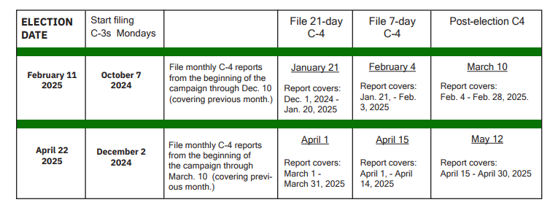
2025 Key Dates: Special Elections
Notes:
Cover or skip, based on class date

Slide 44
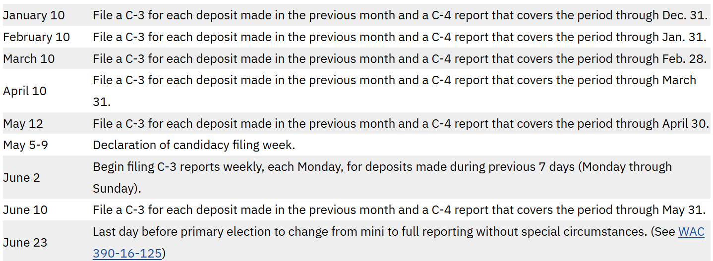
2025 Key Reporting Dates
Notes:
Cover or skip, based on class date

Slide 45
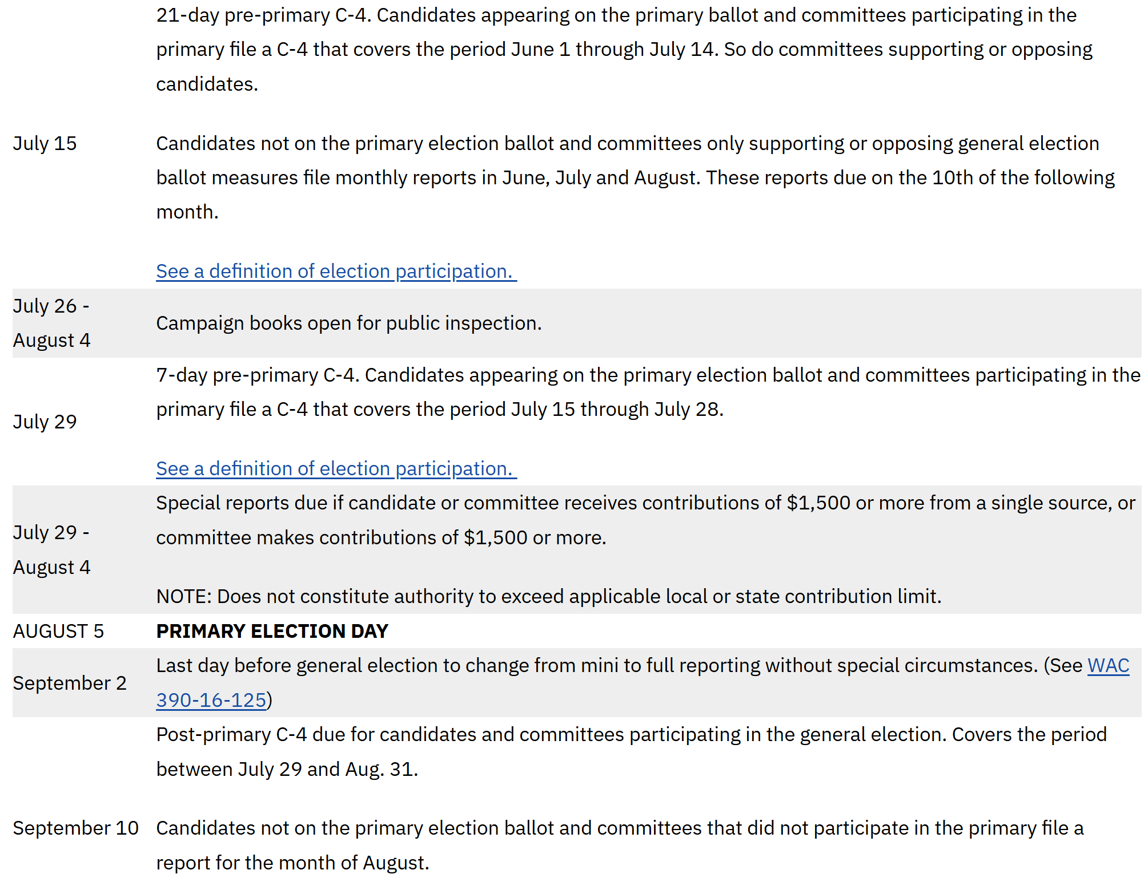
2025 Key Reporting Dates
Notes:
Cover or skip, based on class date

Slide 46
2025 Key Reporting Dates
Notes:
Cover or skip, based on class date

Slide 47
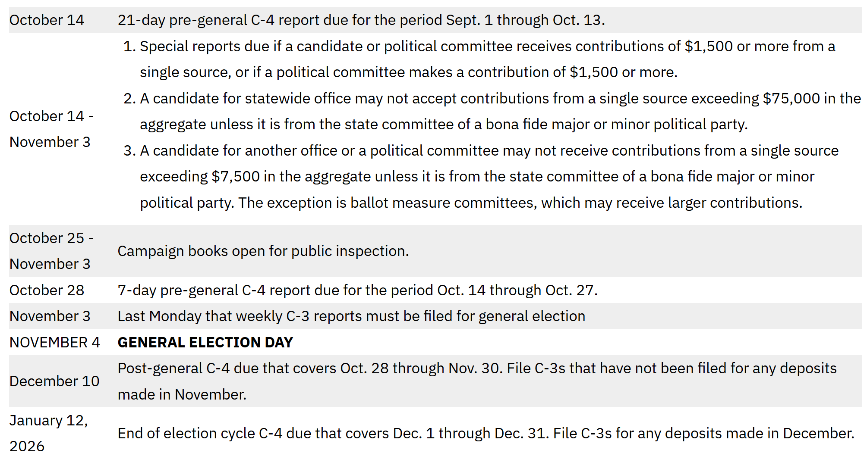
2025 Key Reporting Dates
Notes:
Cover or skip, based on class date

Slide 48
Advertising
The importance of identifying sponsors
Notes:
Let’s move into political advertising and the importance of identifying sponsors
There’s a link in your class email to our advertising guidance
Most political advertising requires you to list the sponsor
Click to next slide to start explaining

Slide 49



Who is an Ad Sponsor?
The committee or person paying for the ad
Sometimes the campaign itself
If no cost, the person who arranges the ad
Notes:
The sponsor is…(talk through slide)
Normally, the advertisement will list the sponsor by saying “Paid for by…” or “Sponsored by…” and there are rules about what must be included

Slide 50
Advertising: Sponsor ID
METHOD | WHAT TO INCLUDE | OTHER THINGS TO KNOW
Print ads | Name, address, any party affiliation | 10 pt. type, ID on first page
Websites | Name, address, any party affiliation | Can’t be hidden or blocked
Broadcast | Name, any party affiliation | For TV or video, see top 3-5 info
Yard signs | Name, address, any party affiliation | Font must be 10% of largest on sign
Office sought and treasurer name are not required.
See website for suggested wording and many other details.
Notes:
This table shows some of the requirements for listing the sponsor
Talk through slide
Point out extra information, if desired:
If it’s a partisan office, must put party name or symbol - no exceptions in all advertising
An ad opposing a certain candidate needs party affiliation
Info about how recent photos need to be (1 within five years)

Slide 51

Key Point
Some forms of advertising are exempt from sponsor ID.
Others have many requirements.
Please investigate further.
Notes:
It’s important to know that some forms of advertising are exempt from the sponsor ID requirement, while others have many requirements
Changes have been made over the past few years, so do some investigating on our website before you order advertising

Slide 52
More About Advertising
RCW 42.17A.480
Charging money for an endorsement or media coverage is illegal
“No person may solicit a candidate, political committee, political party or other person for money in exchange for an endorsement or an article in the news media supporting or opposing a candidate, committee or party”
Notes:
This is something else to know about advertising
According to RCW, charging for an endorsement or media coverage is illegal
The RCW says…(read quote from RCW)
For example, if you the candidate were approached by a media person who said, “if you purchase an ad in our magazine, we will endorse you,” that would be a violation of the law
Endorsements must come unencumbered
And this leads us to 8 major violations that you really want to avoid

Slide 53
8 Major Violations
Cannot charge for endorsement or media coverage
Cannot use public agency facilities for campaigns
Elected officials cannot solicit contributions from an employee in the official’s agency
Candidates cannot use campaign money for spending outside the campaign
Notes:
Of course everyone plans to follow all disclosure laws and no violations are condoned, but I want to talk about 8 violations that tend to bring the biggest consequences, including the possibility of stiff penalties
Some of these we’ve covered already, but they’re worth noting again
The first one we just talked about
Number 2 we also covered, but again: you can’t use a public facility to assist with campaigns unless it’s the regular and normal behavior of the facility
Number 3: If you are an elected official, you can’t solicit contributions from an employee in your agency
An elected official can ACCEPT contributions, but not solicit them
For example, the Mayor of Olympia can’t solicit contributions from city employees
Candidates not yet elected can, but need to check their agency’s rules and follow those
Number 4 we discussed: a candidate’s campaign spending must be for the campaign. Remember we talked about the gas in the car example.

Slide 54
8 Major Violations
Cannot exceed the anonymous contribution limit
Cannot reimburse another person for a contribution
Candidates cannot use campaign funds to assist other candidates or committees
Cannot conceal truth by withholding or substituting information
Notes:
Number 5: There are limits to anonymous contributions and you should not be seeking anonymous donations. We discussed that at length.
Number 6: You cannot pay back someone for a contribution they made. Remember: contributor information must be reported, and if someone gets reimbursed for their contribution, they are not really the donor.
Number 7: Candidates cannot use campaign funds to assist another candidate or committee
For example, a candidate can’t use campaign funds to attend a party committee dinner. This is because any profits made at the dinner are essentially donations to other campaigns. (Elaborate on cost of consumables, if desired)
As another example, if 2 candidates share the cost of a booth at a fair, they must do so equally. If one pays the whole thing, they are contributing to the other person’s campaign.
Number 8 is about concealment and the whole purpose of disclosure law (click to next slide for key point)
IN CASE ASKED:
On bundling contributions: Individuals may, but organizations can’t

Slide 55
Key Point
Campaign finances in Washington are some of the most transparent in the country.
You must not conceal what you know, if you are required by law to disclose.
Notes:
Read slide -
Concealment can come with stiff penalties
An example of concealment would be withholding the name of a contributor when you do know who it was
Disclosure laws are usually broken out of ignorance, so it’s important to learn the rules and you’ve taken a great step by joining class today
IN CASE IT COMES UP:
2016 GMO bill, grocery manufacturers concealed donors, 18 million dollar fine, largest fine for a campaign finance violation

Slide 56
Thank you!
Remaining Questions?
Notes:
Other than showing you some important places on our website, that concludes the information I wanted to cover today
Are there any remaining questions before we look at the website?

Slide 57
Contacting us
Notes:
There are multiple ways to reach the PDC and lots of information is on our website
I’m going to stop sharing my slides and bring up the PDC website
Stop sharing slides
Screen share website
Point out:
Search bar (works very well on this website)
Information links in top green bar
Links in top white bar
“Get Help”
“FILE ONLINE”
Link to calendar
Thank everyone for attending and close the class

